Slide 1
COMP9024: Data Structures and Algorithms
Week Eight: Sortings and Sets
Hui Wu
Session 2, 2015
http://www.cse.unsw.edu.au/~cs9024

Slide 2
Outline
Merge Sort
Quick Sort
Bucket-Sort
Radix Sort
Sorting Lower Bound
Union-Find Partition Structures

Slide 3
Merge Sort
7 2 ⏐ 9 4 → 2 4 7 9
7 ⏐ 2 → 2 7
9 ⏐ 4 → 4 9
7 → 7
2 → 2
9 → 9
4 → 4

Slide 4
Divide-and-Conquer
Divide-and conquer is a general algorithm design paradigm:
  Divide: divide the input data S in two disjoint subsets S₁ and S₂
  Recur: solve the subproblems associated with S₁ and S₂
  Conquer: combine the solutions for S₁ and S₂ into a solution for S
The base case for the recursion are subproblems of size 0 or 1
Merge-sort is a sorting algorithm based on the divide-and-conquer paradigm
Like heap-sort
  It uses a comparator
  It has O(n log n) running time
Unlike heap-sort
  It does not use an auxiliary priority queue
  It accesses data in a sequential manner (suitable to sort data on a disk)

Slide 5
Merge-Sort
Merge-sort on an input sequence S with n elements consists of three steps:
  Divide: partition S into two sequences S₁ and S₂ of about n/2 elements each
  Recur: recursively sort S₁ and S₂
  Conquer: merge S₁ and S₂ into a unique sorted sequence
Algorithm mergeSort(S, C)
Input sequence S with n elements, comparator C
Output sequence S sort according to C
{
if ( S.size() > 1 )
{
(S₁, S₂) = partition(S, n/2);
mergeSort(S₁, C);
mergeSort(S₂, C);
S = merge(S₁, S₂);
}
}

Slide 6
Merging Two Sorted Sequences
The conquer step of merge-sort consists of merging two sorted sequences A and B into a sorted sequence S containing the union of the elements of A and B
Merging two sorted sequences, each with n/2 elements and implemented by means of a doubly linked list, takes O(n) time
Algorithm merge(A, B)
Input sequences A and B with n/2 elements each
Output sorted sequence of A ∪ B
{
S = empty sequence;
while ( ¬A.isEmpty() ∧ ¬B.isEmpty() )
if ( A.first().element() < B.first().element() )
S.insertLast(A.remove(A.first()));
else
S.insertLast(B.remove(B.first()));
while ( ¬A.isEmpty()
S.insertLast(A.remove(A.first()));
while ( ¬B.isEmpty() )
S.insertLast(B.remove(B.first()));
return S;
}

Slide 7
Merge-Sort Tree
An execution of merge-sort is depicted by a binary tree
  each node represents a recursive call of merge-sort and stores
    unsorted sequence before the execution and its partition
    sorted sequence at the end of the execution
  the root is the initial call
  the leaves are calls on subsequences of size 0 or 1
7 2 ⏐ 9 4 → 2 4 7 9
7 ⏐ 2 → 2 7
9 ⏐ 4 → 4 9
7 → 7
2 → 2
9 → 9
4 → 4

Slide 8
Execution Example (1/10)
Partition
7 2 9 4 ⏐ 3 8 6 1 → 1 2 3 4 6 7 8 9
7 2 9 4 → 2 4 7 9
3 8 6 1 → 1 3 8 6
7 2 → 2 7
9 4 → 4 9
3 8 → 3 8
6 1 → 1 6
7 → 7
2 → 2
9 → 9
4 → 4
3 → 3
8 → 8
6 → 6
1 → 1

Slide 9
Execution Example (2/10)
Recursive call, partition
7 2 9 4 ⏐ 3 8 6 1 → 1 2 3 4 6 7 8 9
7 2 ⏐ 9 4 → 2 4 7 9
3 8 6 1 → 1 3 8 6
7 2 → 2 7
9 4 → 4 9
3 8 → 3 8
6 1 → 1 6
7 → 7
2 → 2
9 → 9
4 → 4
3 → 3
8 → 8
6 → 6
1 → 1

Slide 10
Execution Example (3/10)
Recursive call, partition
7 2 9 4 ⏐ 3 8 6 1 → 1 2 3 4 6 7 8 9
7 2 ⏐ 9 4 → 2 4 7 9
3 8 6 1 → 1 3 8 6
7 ⏐ 2 → 2 7
9 4 → 4 9
3 8 → 3 8
6 1 → 1 6
7 → 7
2 → 2
9 → 9
4 → 4
3 → 3
8 → 8
6 → 6
1 → 1

Slide 11
Execution Example (4/10)
Recursive call, base case
7 2 9 4 ⏐ 3 8 6 1 → 1 2 3 4 6 7 8 9
7 2 ⏐ 9 4 → 2 4 7 9
3 8 6 1 → 1 3 8 6
7 ⏐ 2 → 2 7
9 4 → 4 9
3 8 → 3 8
6 1 → 1 6
7 → 7
2 → 2
9 → 9
4 → 4
3 → 3
8 → 8
6 → 6
1 → 1

Slide 12
Execution Example (5/10)
Recursive call, base case
7 2 9 4 ⏐ 3 8 6 1 → 1 2 3 4 6 7 8 9
7 2 ⏐ 9 4 → 2 4 7 9
3 8 6 1 → 1 3 8 6
7 ⏐ 2 → 2 7
9 4 → 4 9
3 8 → 3 8
6 1 → 1 6
7 → 7
2 → 2
9 → 9
4 → 4
3 → 3
8 → 8
6 → 6
1 → 1

Slide 13
Execution Example (6/10)
Merge
7 2 9 4 ⏐ 3 8 6 1 → 1 2 3 4 6 7 8 9
7 2 ⏐ 9 4 → 2 4 7 9
3 8 6 1 → 1 3 8 6
7 ⏐ 2 → 2 7
9 4 → 4 9
3 8 → 3 8
6 1 → 1 6
7 → 7
2 → 2
9 → 9
4 → 4
3 → 3
8 → 8
6 → 6
1 → 1

Slide 14
Execution Example (7/10)
Recursive call, …, base case, merge
7 2 9 4 ⏐ 3 8 6 1 → 1 2 3 4 6 7 8 9
7 2 ⏐ 9 4 → 2 4 7 9
3 8 6 1 → 1 3 8 6
7 ⏐ 2 → 2 7
9 4 → 4 9
3 8 → 3 8
6 1 → 1 6
7 → 7
2 → 2
9 → 9
4 → 4
3 → 3
8 → 8
6 → 6
1 → 1

Slide 15
Execution Example (8/10)
Merge
7 2 9 4 ⏐ 3 8 6 1 → 1 2 3 4 6 7 8 9
7 2 ⏐ 9 4 → 2 4 7 9
3 8 6 1 → 1 3 8 6
7 ⏐ 2 → 2 7
9 4 → 4 9
3 8 → 3 8
6 1 → 1 6
7 → 7
2 → 2
9 → 9
4 → 4
3 → 3
8 → 8
6 → 6
1 → 1

Slide 16
Execution Example (9/10)
Recursive call, …, merge, merge
7 2 9 4 ⏐ 3 8 6 1 → 1 2 3 4 6 7 8 9
7 2 ⏐ 9 4 → 2 4 7 9
3 8 6 1 → 1 3 6 8
7 ⏐ 2 → 2 7
9 4 → 4 9
3 8 → 3 8
6 1 → 1 6
7 → 7
2 → 2
9 → 9
4 → 4
3 → 3
8 → 8
6 → 6
1 → 1

Slide 17
Execution Example (10/10)
Merge
7 2 9 4 ⏐ 3 8 6 1 → 1 2 3 4 6 7 8 9
7 2 ⏐ 9 4 → 2 4 7 9
3 8 6 1 → 1 3 6 8
7 ⏐ 2 → 2 7
9 4 → 4 9
3 8 → 3 8
6 1 → 1 6
7 → 7
2 → 2
9 → 9
4 → 4
3 → 3
8 → 8
6 → 6
1 → 1

Slide 18
Analysis of Merge-Sort
The height h of the merge-sort tree is O(log n)
  at each recursive call we divide in half the sequence,
The overall amount of work done at the nodes of depth i is O(n)
  we partition and merge 2^{i} sequences of size n/2^{i}
  we make 2^{i+1} recursive calls
Thus, the total running time of merge-sort is O(n log n)
depth | #seqs | size
0 | 1 | n
1 | 2 | n/2
i | 2^{i} | n/2^{i}
… | … | …

Slide 19
Summary of Sorting Algorithms
Algorithm | Time | Notes
selection-sort | O(n²) | slow in-place for small data sets (< 1K)
insertion-sort | O(n²) | slow in-place for small data sets (< 1K)
heap-sort | O(n log n) | fast in-place for large data sets (1K — 1M)
merge-sort | O(n log n) | fast sequential data access for huge data sets (> 1M)

Slide 20
Nonrecursive Merge-Sort
public static void mergeSort(Object[] orig, Comparator c) { // nonrecursive
Object[] in = new Object[orig.length]; // make a new temporary array
System.arraycopy(orig,0,in,0,in.length); // copy the input
Object[] out = new Object[in.length]; // output array
Object[] temp; // temp array reference used for swapping
int n = in.length;
for (int i=1; i < n; i*=2) { // each iteration sorts all length-2*i runs
for (int j=0; j < n; j+=2*i) // each iteration merges two length-i pairs
merge(in,out,c,j,i); // merge from in to out two length-i runs at j
temp = in; in = out; out = temp; // swap arrays for next iteration
}
// the "in" array contains the sorted array, so re-copy it
System.arraycopy(in,0,orig,0,in.length);
}
protected static void merge(Object[] in, Object[] out, Comparator c, int start,
int inc) { // merge in[start..start+inc-1] and in[start+inc..start+2*inc-1]
int x = start; // index into run #1
int end1 = Math.min(start+inc, in.length); // boundary for run #1
int end2 = Math.min(start+2*inc, in.length); // boundary for run #2
int y = start+inc; // index into run #2 (could be beyond array boundary)
int z = start; // index into the out array
while ((x < end1) && (y < end2))
if (c.compare(in[x],in[y]) <= 0) out[z++] = in[x++];
else out[z++] = in[y++];
if (x < end1) // first run didn't finish
System.arraycopy(in, x, out, z, end1 - x);
else if (y < end2) // second run didn't finish
System.arraycopy(in, y, out, z, end2 - y);
}
merge runs of length 2, then 4, then 8, and so on
merge two runs in the in array to the out array

Slide 21
Quick-Sort
7 4 9 6 2 → 2 4 6 7 9
4 2 → 2 4
7 9 → 7 9
2 → 2
9 → 9

Slide 22
Quick-Sort
Quick-sort is a randomized sorting algorithm based on the divide-and-conquer paradigm:
  Divide: pick a random element x (called pivot) and partition S into
    L elements less than x
    E elements equal x
    G elements greater than x
  Recur: sort L and G
  Conquer: join L, E and G
x
x
L
G
E
x

Slide 23
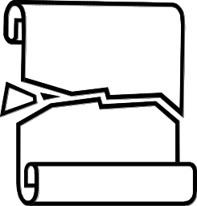
Partition
Algorithm partition(S, p)
Input sequence S, position p of pivot
Output subsequences L, E, G of the
elements of S less than, equal to,
or greater than the pivot, resp.
{ L, E, G = empty sequences;
x = S.remove(p);
while ( ¬S.isEmpty() )
{ y = S.remove(S.first());
if ( y < x )
L.insertLast(y);
else if ( y = x )
E.insertLast(y);
else // y > x
G.insertLast(y);}
return L, E, G;
}
We partition an input sequence as follows:
  We remove, in turn, each element y from S and
  We insert y into L, E or G, depending on the result of the comparison with the pivot x
Each insertion and removal is at the beginning or at the end of a sequence, and hence takes O(1) time
Thus, the partition step of quick-sort takes O(n) time

Slide 24
Quick-Sort Tree
An execution of quick-sort is depicted by a binary tree
  Each node represents a recursive call of quick-sort and stores
    Unsorted sequence before the execution and its pivot
    Sorted sequence at the end of the execution
  The root is the initial call
  The leaves are calls on subsequences of size 0 or 1
7 4 9 6 2 → 2 4 6 7 9
4 2 → 2 4
7 9 → 7 9
2 → 2
9 → 9

Slide 25
Execution Example (1/7)
Pivot selection
7 2 9 4 3 7 6 1 → 1 2 3 4 6 7 8 9
7 2 9 4 → 2 4 7 9
3 8 6 1 → 1 3 8 6
2 → 2
9 4 → 4 9
3 → 3
8 → 8
9 → 9
4 → 4

Slide 26
Execution Example (2/7)
Partition, recursive call, pivot selection
7 2 9 4 3 7 6 1 → 1 2 3 4 6 7 8 9
2 4 3 1 → 2 4 7 9
3 8 6 1 → 1 3 8 6
2 → 2
9 4 → 4 9
3 → 3
8 → 8
9 → 9
4 → 4

Slide 27
Execution Example (3/7)
Partition, recursive call, base case
7 2 9 4 3 7 6 1 → → 1 2 3 4 6 7 8 9
2 4 3 1 →→ 2 4 7
3 8 6 1 → 1 3 8 6
1 → 1
9 4 → 4 9
3 → 3
8 → 8
9 → 9
4 → 4

Slide 28
Execution Example (4/7)
Recursive call, …, base case, join
7 2 9 4 3 7 6 1 → 1 2 3 4 6 7 8 9
2 4 3 1 → 1 2 3 4
3 8 6 1 → 1 3 8 6
1 → 1
4 3 → 3 4
3 → 3
8 → 8
9 → 9
4 → 4

Slide 29
Execution Example (5/7)
Recursive call, pivot selection
7 2 9 4 3 7 6 1 → 1 2 3 4 6 7 8 9
2 4 3 1 → 1 2 3 4
7 9 7 1 → 1 3 8 6
1 → 1
4 3 → 3 4
8 → 8
9 → 9
9 → 9
4 → 4

Slide 30
Execution Example (6/7)
Partition, …, recursive call, base case
7 2 9 4 3 7 6 1 → 1 2 3 4 6 7 8 9
2 4 3 1 → 1 2 3 4
7 9 7 1 → 1 3 8 6
1 → 1
4 3 → 3 4
8 → 8
9 → 9
9 → 9
4 → 4

Slide 31
Execution Example (7/7)
Join, join
7 2 9 4 3 7 6 1 → 1 2 3 4 6 7 7 9
2 4 3 1 → 1 2 3 4
7 9 7 → 17 7 9
1 → 1
4 3 → 3 4
8 → 8
9 → 9
9 → 9
4 → 4

Slide 32
Worst-case Running Time
The worst case for quick-sort occurs when the pivot is the unique minimum or maximum element
One of L and G has size n − 1 and the other has size 0
The running time is proportional to the sum
n + (n − 1) + … + 2 + 1
Thus, the worst-case running time of quick-sort is O(n²)
depth | time
0 | n
1 | n − 1
… | …
n − 1 | 1
…

Slide 33
Expected Running Time (1/2)
Consider a recursive call of quick-sort on a sequence of size s
  Good call: the sizes of L and G are each less than 3s/4
  Bad call: one of L and G has size greater than 3s/4
A call is good with probability 1/2
  1/2 of the possible pivots cause good calls:
7 2 9 4 3 7 6 1 9
7 2 9 4 3 7 6 1
2 4 3 1
7 9 7 1 → 1
1
7 2 9 4 3 7 6
Good call
Bad call
1 2 3 4 5 6 7 8 9 10 11 12 13 14 15 16
Bad pivots
Good pivots
Bad pivots

Slide 34
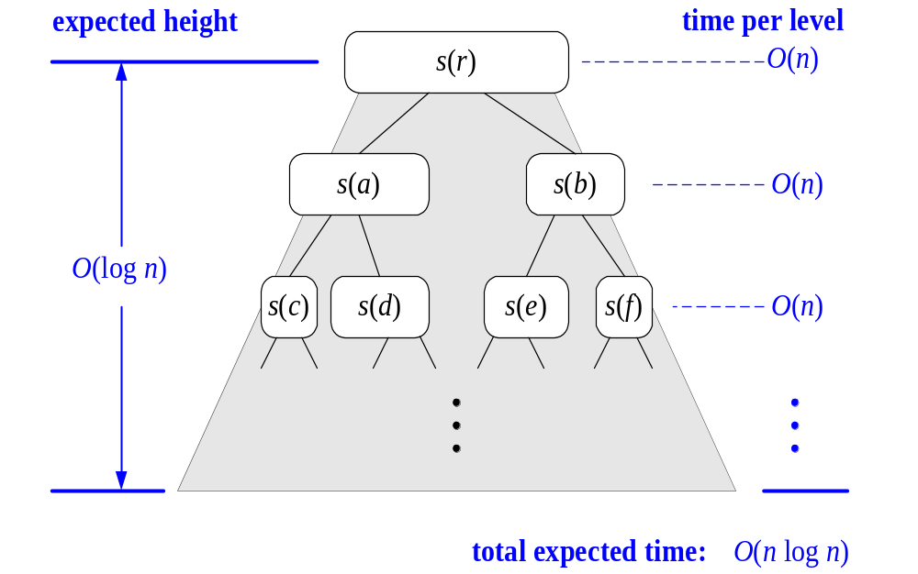
Expected Running Time (2/2)
Probabilistic Fact: The expected number of coin tosses required in order to get k heads is 2k
For a node of depth i, we expect
  i/2 ancestors are good calls
  The size of the input sequence for the current call is at most (3/4)^{i/2}n
Therefore, we have
  For a node of depth 2log_{4/3}n, the expected input size is one
  The expected height of the quick-sort tree is O(log n)
The amount or work done at the nodes of the same depth is O(n)
Thus, the expected running time of quick-sort is O(n log n)

Slide 35

In-Place Quick-Sort
Quick-sort can be implemented to run in-place
In the partition step, we use replace operations to rearrange the elements of the input sequence such that
  the elements less than the pivot have rank less than h
  the elements equal to the pivot have rank between h and k
  the elements greater than the pivot have rank greater than k
The recursive calls consider
  elements with rank less than h
  elements with rank greater than k
Algorithm inPlaceQuickSort(S, l, r)
Input sequence S, ranks l and r
Output sequence S with the
elements of rank between l and r
rearranged in increasing order
{ if ( l ≥ r )
return;
i = a random integer between l and r;
x = S.elemAtRank(i);
(h, k) = inPlacePartition(x);
inPlaceQuickSort(S, l, h − 1);
inPlaceQuickSort(S, k + 1, r);
}

Slide 36
In-Place Partitioning
Perform the partition using two indices to split S into L and E U G (a similar method can split E U G into E and G).
Repeat until j and k cross:
  Scan j to the right until finding an element > x.
  Scan k to the left until finding an element < x.
  Swap elements at indices j and k
j
k
3 2 5 1 0 7 3 5 9 2 7 9 8 9 7 6 9
(pivot = 6)
j
k
3 2 5 1 0 7 3 5 9 2 7 9 8 9 7 6 9

Slide 37
Summary of Sorting Algorithms
Algorithm | Time | Notes
selection-sort | O(n²) | in-place slow (good for small inputs)
insertion-sort | O(n²) | in-place slow (good for small inputs)
quick-sort | O(n log n) expected | in-place, randomized fastest (good for large inputs)
heap-sort | O(n log n) | in-place fast (good for large inputs)
merge-sort | O(n log n) | sequential data access fast (good for huge inputs)

Slide 38
Java Implementation
public static void quickSort (Object[] S, Comparator c) {
if (S.length < 2) return; // the array is already sorted in this case
quickSortStep(S, c, 0, S.length-1); // recursive sort method
}
private static void quickSortStep (Object[] S, Comparator c,
int leftBound, int rightBound ) {
if (leftBound >= rightBound) return; // the indices have crossed
Object temp; // temp object used for swapping
Object pivot = S[rightBound];
int leftIndex = leftBound; // will scan rightward
int rightIndex = rightBound-1; // will scan leftward
while (leftIndex <= rightIndex) { // scan right until larger than the pivot
while ( (leftIndex <= rightIndex) && (c.compare(S[leftIndex], pivot)<=0) )
leftIndex++;
// scan leftward to find an element smaller than the pivot
while ( (rightIndex >= leftIndex) && (c.compare(S[rightIndex], pivot)>=0))
rightIndex--;
if (leftIndex < rightIndex) { // both elements were found
temp = S[rightIndex];
S[rightIndex] = S[leftIndex]; // swap these elements
S[leftIndex] = temp;
}
} // the loop continues until the indices cross
temp = S[rightBound]; // swap pivot with the element at leftIndex
S[rightBound] = S[leftIndex];
S[leftIndex] = temp; // the pivot is now at leftIndex, so recurse
quickSortStep(S, c, leftBound, leftIndex-1);
quickSortStep(S, c, leftIndex+1, rightBound);
}
only works for distinct elements

Slide 39
Bucket-Sort and Radix-Sort
1, c
3, a
3, b
7, d
7, g
7, e
∅
∅
∅
∅
∅
∅
∅
B
0
1
2
3
4
5
6
7
8
9

Slide 40

Bucket-Sort
Let be S be a sequence of n (key, element) entries with keys in the range [0, N − 1]
Bucket-sort uses the keys as indices into an auxiliary array B of sequences (buckets)
  Phase 1: Empty sequence S by moving each entry (k, o) into its bucket B[k]
  Phase 2: For i = 0, …, N − 1, move the entries of bucket B[i] to the end of sequence S
Analysis:
  Phase 1 takes O(n) time
  Phase 2 takes O(n + N) time
Bucket-sort takes O(n + N) time
Algorithm bucketSort(S, N)
Input sequence S of (key, element)
items with keys in the range [0, N − 1]
Output sequence S sorted by increasing
keys
{ B = array of N empty sequences;
while ( ¬S.isEmpty() )
{ f = S.first();
(k, o) = S.remove(f);
B[k].insertLast((k, o)); }
for ( i = 0; i++; i <=N − 1)
while ( ¬B[i].isEmpty() )
{ f = B[i].first();
(k, o) = B[i].remove(f);
S.insertLast((k, o)); }
}

Slide 41

Example
Key range [0, 9]
7, d
1, c
3, a
7, g
3, b
7, e
Phase 1
1, c
3, a
3, b
7, d
7, g
7, e
B
0
1
2
3
4
5
6
7
8
9
∅
∅
∅
∅
∅
∅
∅
Phase 2
1, c
3, a
3, b
7, d
7, g
7, e

Slide 42

Properties and Extensions
Key-type Property
  The keys are used as indices into an array and cannot be arbitrary objects
  No external comparator
Stable Sort Property
  The relative order of any two items with the same key is preserved after the execution of the algorithm
Extensions
  Integer keys in the range [a, b]
    Put entry (k, o) into bucket
    B[k − a]
  String keys from a set D of possible strings, where D has constant size (e.g., names of the 50 U.S. states)
    Sort D and compute the rank r(k) of each string k of D in the sorted sequence
    Put entry (k, o) into bucket
    B[r(k)]

Slide 43

Lexicographic Order
A d-tuple is a sequence of d keys (k₁, k₂, …, k_{d}), where key k_{i} is said to be the i-th dimension of the tuple
Example:
  The Cartesian coordinates of a point in space are a 3-tuple
The lexicographic order of two d-tuples is recursively defined as follows
(x₁, x₂, …, x_{d}) < (y₁, y₂, …, y_{d})
⇔
x₁ < y₁ ∨ x₁ = y₁ ∧ (x₂, …, x_{d}) < (y₂, …, y_{d})
I.e., the tuples are compared by the first dimension, then by the second dimension, etc.

Slide 44
Lexicographic-Sort
Let C_{i} be the comparator that compares two tuples by their i-th dimension
Let stableSort(S, C) be a stable sorting algorithm that uses comparator C
Lexicographic-sort sorts a sequence of d-tuples in lexicographic order by executing d times algorithm stableSort, one per dimension
Lexicographic-sort runs in O(dT(n)) time, where T(n) is the running time of stableSort
Algorithm lexicographicSort(S)
Input sequence S of d-tuples
Output sequence S sorted in
lexicographic order
{ for ( i = d; i>=1; i--; )
stableSort(S, C_{i});
}
Example:
(7,4,6) (5,1,5) (2,4,6) (2, 1, 4) (3, 2, 4)
(2, 1, 4) (3, 2, 4) (5,1,5) (7,4,6) (2,4,6)
(2, 1, 4) (5,1,5) (3, 2, 4) (7,4,6) (2,4,6)
(2, 1, 4) (2,4,6) (3, 2, 4) (5,1,5) (7,4,6)

Slide 45
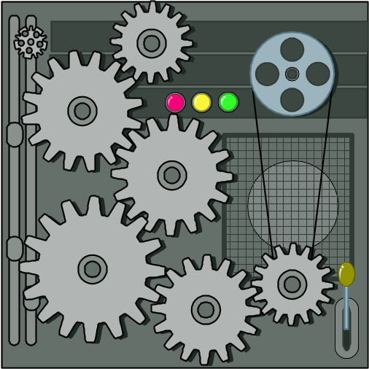
Radix-Sort
Radix-sort is a specialization of lexicographic-sort that uses bucket-sort as the stable sorting algorithm in each dimension
Radix-sort is applicable to tuples where the keys in each dimension i are integers in the range [0, N − 1]
Radix-sort runs in time O(d( n + N))
Algorithm radixSort(S, N)
Input sequence S of d-tuples such
that (0, …, 0) ≤ (x₁, …, x_{d}) and
(x₁, …, x_{d}) ≤ (N − 1, …, N − 1)
for each tuple (x₁, …, x_{d}) in S
Output sequence S sorted in
lexicographic order
{ for ( i = d; i>=1; i-- )
bucketSort(S, N);
}

Slide 46

Radix-Sort for Binary Numbers
Consider a sequence of n b-bit integers
x = x_{b − 1} … x₁x₀
We represent each element as a b-tuple of integers in the range [0, 1] and apply radix-sort with N = 2
This application of the radix-sort algorithm runs in O(bn) time
For example, we can sort a sequence of 32-bit integers in linear time
Algorithm binaryRadixSort(S)
Input sequence S of b-bit
integers
Output sequence S sorted
replace each element x
of S with the item (0, x)
{ for ( i = 0; i<= b−1; i++ )
{ replace the key k of
each item (k, x) of S with bit x_{i} of x;
bucketSort(S, 2);
}
}

Slide 47
Example
Sorting a sequence of 4-bit integers
1001
0010
1001
1001
0001
0010
1110
1101
0001
0010
1101
1001
0001
0010
1001
0001
1101
0010
1101
1101
1110
0001
1110
1110
1110

Slide 48

Sorting Lower Bound

Slide 49

Comparison-Based Sorting
Many sorting algorithms are comparison based.
  They sort by making comparisons between pairs of objects
  Examples: bubble-sort, selection-sort, insertion-sort, heap-sort, merge-sort, quick-sort, ...
Let us therefore derive a lower bound on the running time of any algorithm that uses comparisons to sort n elements, x₁, x₂, …, x_{n}.
Is x_{i} < x_{j}?
no
yes

Slide 50
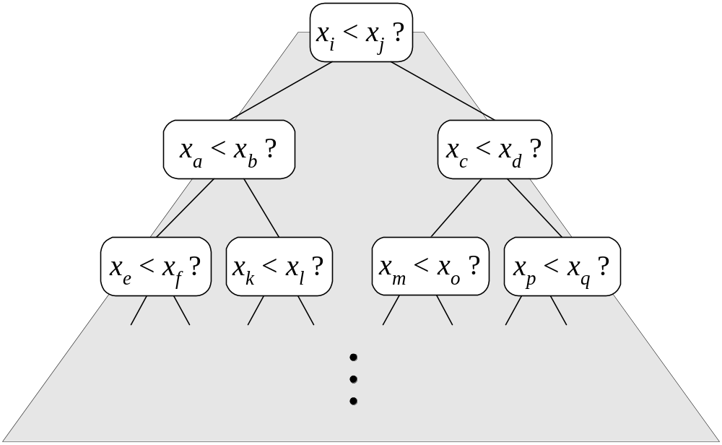
Counting Comparisons
Let us just count comparisons then.
Each possible run of the algorithm corresponds to a root-to-leaf path in a decision tree

Slide 51
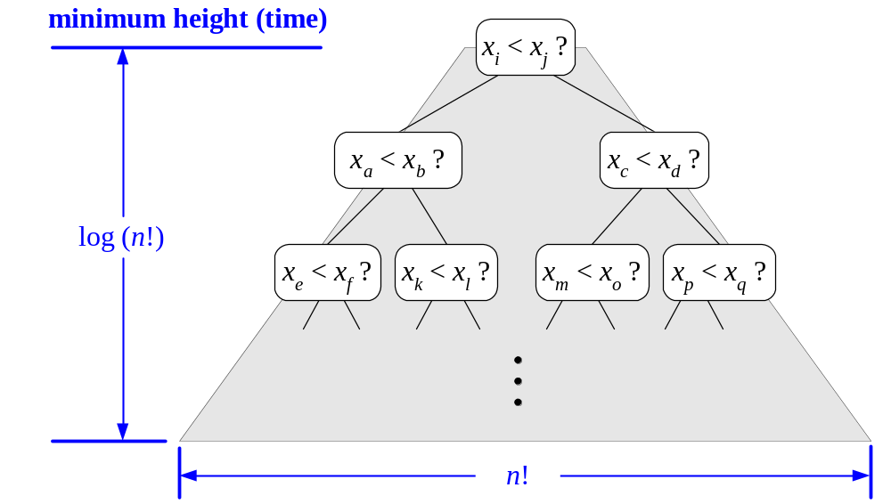
Decision Tree Height
The height of this decision tree is a lower bound on the running time
Every possible input permutation must lead to a separate leaf output.
  If not, some input …4…5… would have same output ordering as …5…4…, which would be wrong.
Since there are n!=1*2*…*n leaves, the height is at least log (n!)

Slide 52

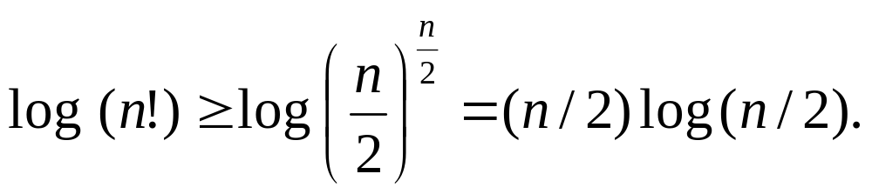
The Lower Bound
Any comparison-based sorting algorithms takes at least log (n!) time
Therefore, any such algorithm takes time at least
That is, any comparison-based sorting algorithm must run in Ω(n log n) time.

Slide 53

Selection

Slide 54

The Selection Problem
Given an integer k and n elements x₁, x₂, …, x_{n}, taken from a total order, find the k-th smallest element in this set.
Of course, we can sort the set in O(n log n) time and then index the k-th element.
Can we solve the selection problem faster?
k=3
7 4 9 6 2 → 2 4 6 7 9

Slide 55
Quick-Select
Quick-select is a randomized selection algorithm based on the prune-and-search paradigm:
  Prune: pick a random element x (called pivot) and partition S into
    L elements less than x
    E elements equal x
    G elements greater than x
  Search: depending on k, either answer is in E, or we need to recurse in either L or G
x
x
L
G
E
k < |L|
k > |L|+|E|
k’ = k - |L| - |E|
|L| < k < |L|+|E|
(done)

Slide 56
Partition
Algorithm partition(S, p)
Input sequence S, position p of pivot
Output subsequences L, E, G of the
elements of S less than, equal to,
or greater than the pivot, resp.
{ L, E, G = empty sequences;
x = S.remove(p);
while ( ¬S.isEmpty() )
{ y = S.remove(S.first());
if ( y < x )
L.insertLast(y);
else if ( y = x )
E.insertLast(y);
else // y > x
G.insertLast(y); }
return L, E, G;
}
We partition an input sequence as in the quick-sort algorithm:
  We remove, in turn, each element y from S and
  We insert y into L, E or G, depending on the result of the comparison with the pivot x
Each insertion and removal is at the beginning or at the end of a sequence, and hence takes O(1) time
Thus, the partition step of quick-select takes O(n) time

Slide 57
Quick-Select Visualization
An execution of quick-select can be visualized by a recursion path
  Each node represents a recursive call of quick-select, and stores k and the remaining sequence
k=5, S=(7 4 9 3 2 6 5 1 8)
k=2, S=(7 4 9 6 5 8)
k=2, S=(7 4 6 5)
k=1, S=(7 6 5)
5

Slide 58
Expected Running Time (1/2)
Consider a recursive call of quick-select on a sequence of size s
  Good call: the sizes of L and G are each less than 3s/4
  Bad call: one of L and G has size greater than 3s/4
A call is good with probability 1/2
  1/2 of the possible pivots cause good calls:
7 2 9 4 3 7 6 1 9
7 2 9 4 3 7 6 1
2 4 3 1
7 9 7 1 → 1
1
7 2 9 4 3 7 6
Good call
Bad call
1 2 3 4 5 6 7 8 9 10 11 12 13 14 15 16
Bad pivots
Good pivots
Bad pivots

Slide 59
Expected Running Time (2/2)
Probabilistic Fact #1: The expected number of coin tosses required in order to get one head is two
Probabilistic Fact #2: Expectation is a linear function:
  E(X + Y ) = E(X ) + E(Y )
  E(cX ) = cE(X )
Let T(n) denote the expected running time of quick-select.
By Fact #2,
  T(n) < T(3n/4) + bn*(expected # of calls before a good call)
By Fact #1,
  T(n) < T(3n/4) + 2bn
That is, T(n) is a geometric series:
  T(n) < 2bn + 2b(3/4)n + 2b(3/4)²n + 2b(3/4)³n + …
So T(n) is O(n).
We can solve the selection problem in O(n) expected time.

Slide 60

Deterministic Selection
We can do selection in O(n) worst-case time.
Main idea: recursively use the selection algorithm itself to find a good pivot for quick-select:
  Divide S into n/5 sets of 5 each
  Find a median in each set
  Recursively find the median of the “baby” medians.
See Exercise C-11.31 for details of analysis.
Min size
for L
1
1
1
1
1
1
1
1
1
1
1
2
2
2
2
2
2
2
2
2
2
2
3
3
3
3
3
3
3
3
3
3
3
Min size
for G
4
4
4
4
4
4
4
4
4
4
4
5
5
5
5
5
5
5
5
5
5
5

Slide 61

Sets

Slide 62

Set Operations
We represent a set by the sorted sequence of its elements
By specializing the auxliliary methods he generic merge algorithm can be used to perform basic set operations:
  union
  intersection
  subtraction
The running time of an operation on sets A and B should be at most O(n_{A} + n_{B})
Set union:
  aIsLess(a, S)
  S.insertFirst(a)
  bIsLess(b, S)
  S.insertLast(b)
  bothAreEqual(a, b, S)
  S. insertLast(a)
Set intersection:
  aIsLess(a, S)
  { do nothing }
  bIsLess(b, S)
  { do nothing }
  bothAreEqual(a, b, S)
  S. insertLast(a)

Slide 63




Storing a Set in a List
We can implement a set with a list
Elements are stored sorted according to some canonical ordering
The space used is O(n)
Nodes storing set elements in order
List
∅
Set elements

Slide 64
Generic Merging
Generalized merge of two sorted lists A and B
Template method genericMerge
Auxiliary methods
  aIsLess
  bIsLess
  bothAreEqual
Runs in O(n_{A} + n_{B}) time provided the auxiliary methods run in O(1) time
Algorithm genericMerge(A, B)
{ S = empty sequence;
  while ( ¬A.isEmpty() ∧ ¬B.isEmpty() )
  { a = A.first().element(); b ← B.first().element(); }
  if ( a < b )
  { aIsLess(a, S); A.remove(A.first()); }
  else if ( b < a )
  { bIsLess(b, S); B.remove(B.first()); }
  else // b = a
  { bothAreEqual(a, b, S);
  A.remove(A.first()); B.remove(B.first()); }
  while ( ¬A.isEmpty() )
  { aIsLess(a, S); A.remove(A.first()); }
  while ( ¬B.isEmpty() )
  { bIsLess(b, S); B.remove(B.first()); }
  return S; }

Slide 65

Using Generic Merge for Set Operations
Any of the set operations can be implemented using a generic merge
For example:
  For intersection: only copy elements that are duplicated in both list
  For union: copy every element from both lists except for the duplicates
All methods run in linear time.

Slide 66

Union-Find Partition Structures

Slide 67
Partitions with Union-Find Operations
makeSet(x): Create a singleton set containing the element x and return the position storing x in this set.
union(A,B ): Return the set A U B, destroying the old A and B.
find(p): Return the set containing the element in position p.

Slide 68
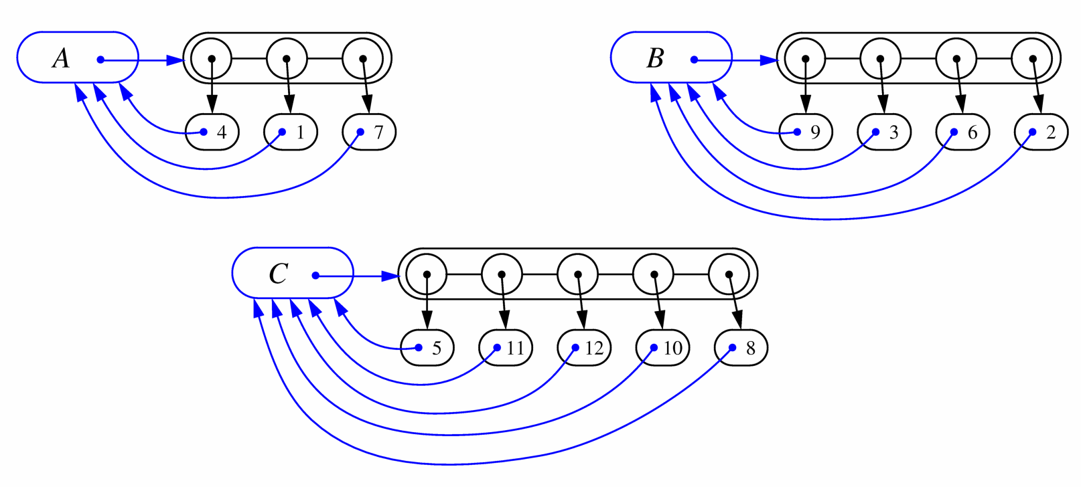
List-based Implementation
Each set is stored in a sequence represented with a linked-list
Each node should store an object containing the element and a reference to the set name

Slide 69
Analysis of List-based Representation
When doing a union, always move elements from the smaller set to the larger set
  Each time an element is moved it goes to a set of size at least double its old set
  Thus, an element can be moved at most O(log n) times
Total time needed to do n unions and finds is O(n log n).

Slide 70
Tree-based Implementation
Each element is stored in a node, which contains a pointer to a set name
A node v whose set pointer points back to v is also a set name
Each set is a tree, rooted at a node with a self-referencing set pointer
For example: The sets “1”, “2”, and “5”:
1
2
5
4
7
3
6
8
10
9
11
12

Slide 71
Union-Find Operations
5
To do a union, simply make the root of one tree point to the root of the other
To do a find, follow set-name pointers from the starting node until reaching a node whose set-name pointer refers back to itself
2
8
10
3
6
11
9
12
5
2
8
10
3
6
11
9
12

Slide 72
Union-Find Heuristic 1
Union by size:
  When performing a union, make the root of smaller tree point to the root of the larger
Implies O(n log n) time for performing n union-find operations:
  Each time we follow a pointer, we are going to a subtree of size at least double the size of the previous subtree
  Thus, we will follow at most O(log n) pointers for any find.
5
2
8
10
3
6
11
9
12

Slide 73
Union-Find Heuristic 2
Path compression:
  After performing a find, compress all the pointers on the path just traversed so that they all point to the root
Implies O(n log* n) time for performing n union-find operations:
  Proof is somewhat involved… (and not in the book)
5
5
8
10
8
10
11
11
2
12
2
12
3
6
3
6
9
9

Slide 74
Proof of log* n Amortized Time
For each node v that is a root
  define n(v) to be the size of the subtree rooted at v (including v)
  identified a set with the root of its associated tree.
We update the size field of v each time a set is unioned into v. Thus, if v is not a root, then n(v) is the largest the subtree rooted at v can be, which occurs just before we union v into some other node whose size is at least as large as v ’s.
For any node v, then, define the rank of v, which we denote as r (v), as r (v) = [log n(v)]:
Thus, n(v) ≥ 2^{r(v)}.
Also, since there are at most n nodes in the tree of v, r (v) = [logn], for each node v.

Slide 75
Proof of log* n Amortized Time (2)
For each node v with parent w:
  r (v ) > r (w )
Claim: There are at most n/ 2^{s} nodes of rank s.
Proof:
  Since r (v) < r (w), for any node v with parent w, ranks are monotonically increasing as we follow parent pointers up any tree.
  Thus, if r (v) = r (w) for two nodes v and w, then the nodes counted in n(v) must be separate and distinct from the nodes counted in n(w).
  If a node v is of rank s, then n(v) ≥ 2^{s}.
  Therefore, since there are at most n nodes total, there can be at most n/ 2^{s} that are of rank s.

Slide 76
Proof of log* n Amortized Time (3)
Definition: Tower of two’s function:
  t(i) = 2^{t(i-1)}
Nodes v and u are in the same rank group g if
  g = log*(r(v)) = log*(r(u)):
Since the largest rank is log n, the largest rank group is
  log*(log n) = (log* n)-1

Slide 77
Proof of log* n Amortized Time (4)
Charge 1 cyber-dollar per pointer hop during a find:
  If w is the root or if w is in a different rank group than v, then charge the find operation one cyber-dollar.
  Otherwise (w is not a root and v and w are in the same rank group), charge the node v one cyber-dollar.
Since there are most (log* n)-1 rank groups, this rule guarantees that any find operation is charged at most log* n cyber-dollars.

Slide 78
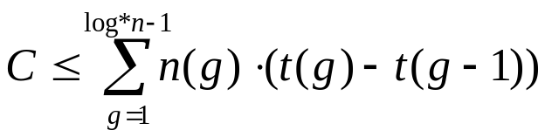
Proof of log* n Amortized Time (5)
After we charge a node v then v will get a new parent, which is a node higher up in v ’s tree.
The rank of v ’s new parent will be greater than the rank of v ’s old parent w.
Thus, any node v can be charged at most the number of different ranks that are in v ’s rank group.
If v is in rank group g > 0, then v can be charged at most t(g)-t(g-1) times before v has a parent in a higher rank group (and from that point on, v will never be charged again). In other words, the total number, C, of cyber-dollars that can ever be charged to nodes can be bound as

Slide 79
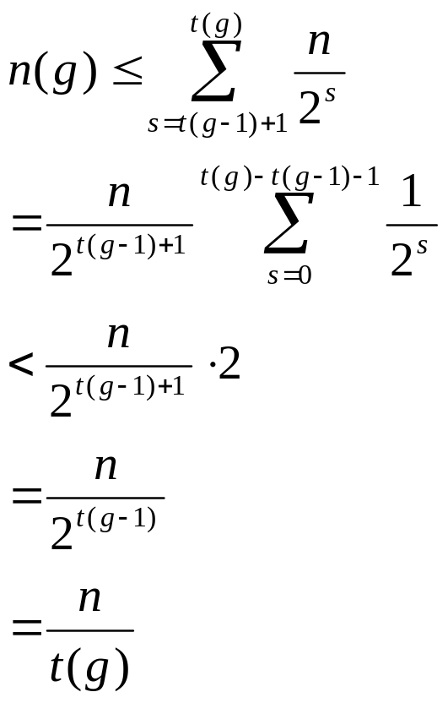
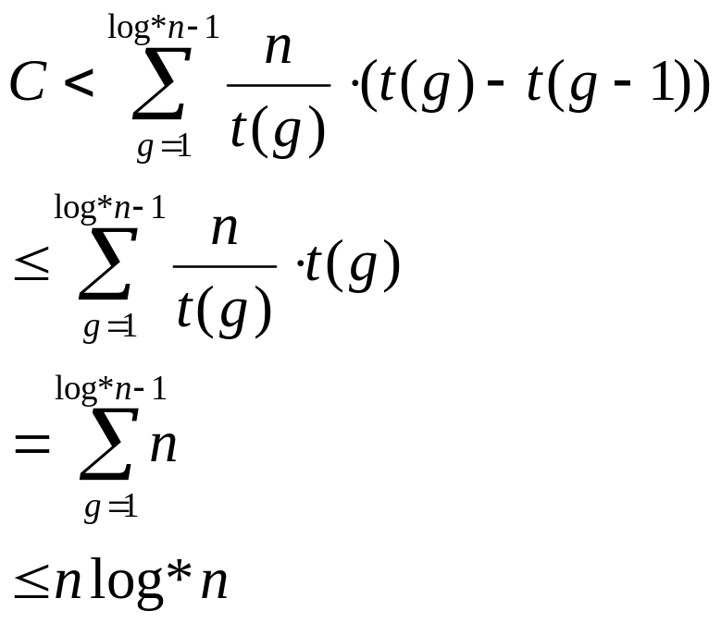
Proof of log* n Amortized Time (end)
Bounding n(g):
Returning to C:

Slide 80
References
Chapter 11, Data Structures and Algorithms by Goodrich and Tamassia.

